Slide 1

ROUND ROBIN CQI BASED CELLULAR NETWORK
Performance evaluation of a RR cqi based cellular network
Antonio Le Caldare, Vincenzo Consales, Vincent della Corte - PECSN
1

Slide 2
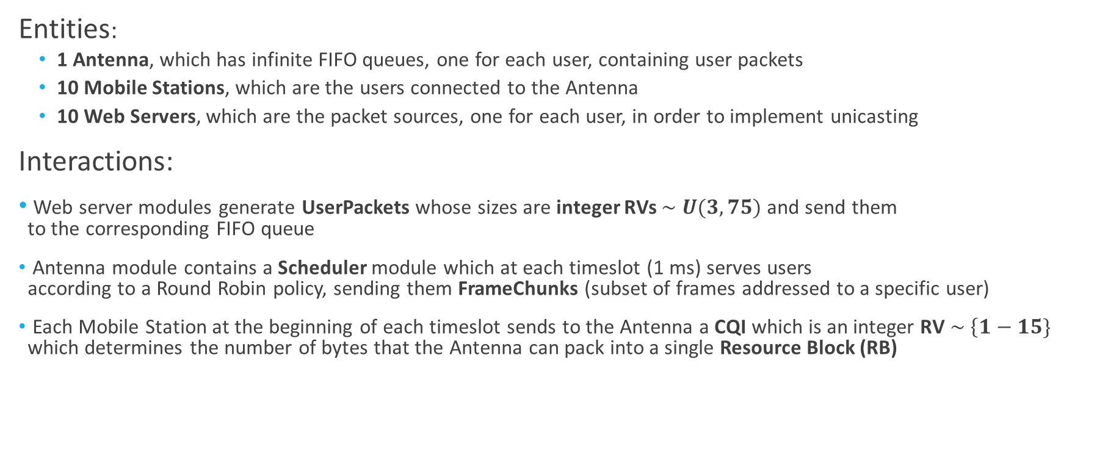
Cellular Network: Model of the System (1/2)
Entities:
1 Antenna, which has infinite FIFO queues, one for each user, containing user packets
10 Mobile Stations, which are the users connected to the Antenna
10 Web Servers, which are the packet sources, one for each user, in order to implement unicasting
Interactions:
Web server modules generate UserPackets whose sizes are integer RVs $\sim U(3, 75)$ and send them to the corresponding FIFO queue
Antenna module contains a Scheduler module which at each timeslot (1 ms) serves users according to a Round Robin policy, sending them FrameChunks (subset of frames addressed to a specific user)
Each Mobile Station at the beginning of each timeslot sends to the Antenna a CQI which is an integer RV $\sim \left\{1−15\}\right.$ which determines the number of bytes that the Antenna can pack into a single Resource Block (RB)
Antonio Le Caldare, Vincenzo Consales, Vincent della Corte - PECSN
2

Slide 3
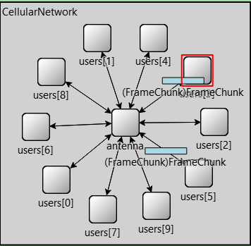
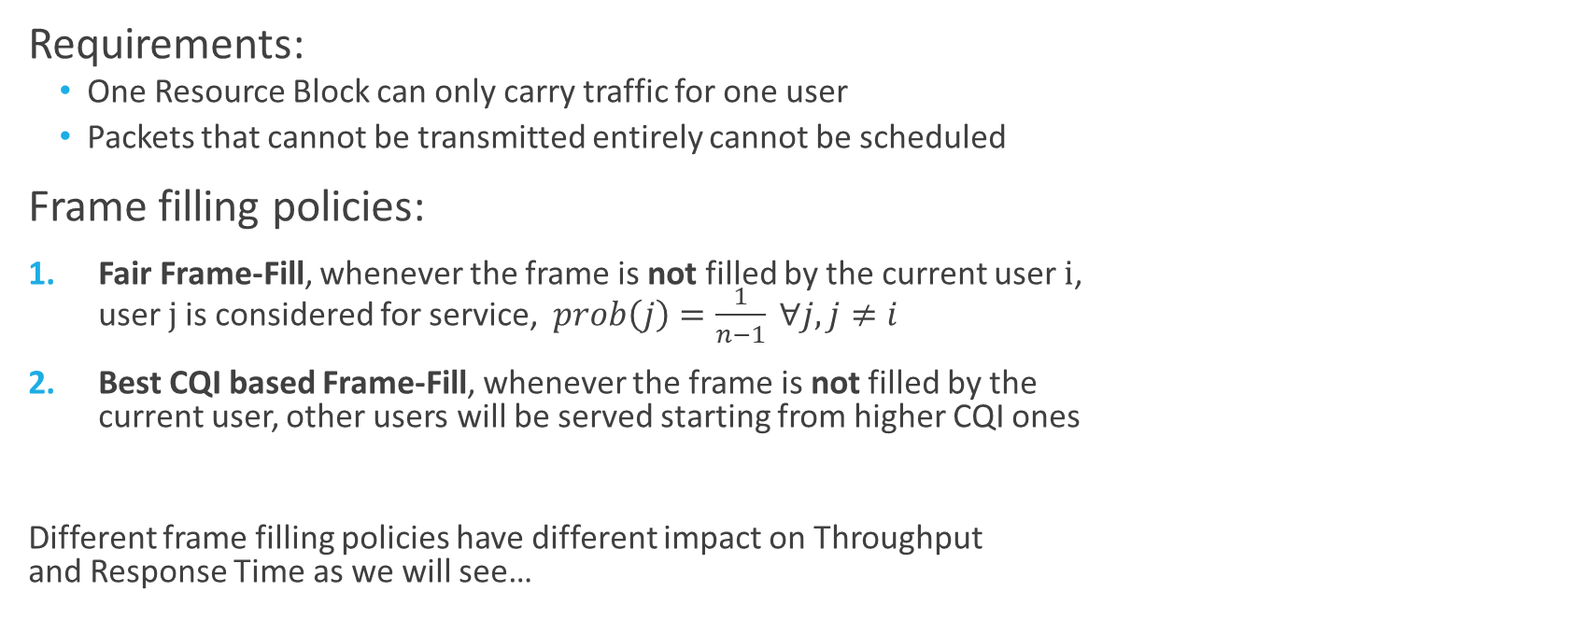
Cellular Network: Model of the System (2/2)
Requirements:
One Resource Block can only carry traffic for one user
Packets that cannot be transmitted entirely cannot be scheduled
Frame filling policies:
Fair Frame-Fill, whenever the frame is not filled by the current user i, user j is considered for service, $prob\left(j\right)=\frac{1}{n−1} ∀j, j≠i$
Best CQI based Frame-Fill, whenever the frame is not filled by the current user, other users will be served starting from higher CQI ones
Different frame filling policies have different impact on Throughput and Response Time as we will see…
Antonio Le Caldare, Vincenzo Consales, Vincent della Corte - PECSN
3

Slide 4
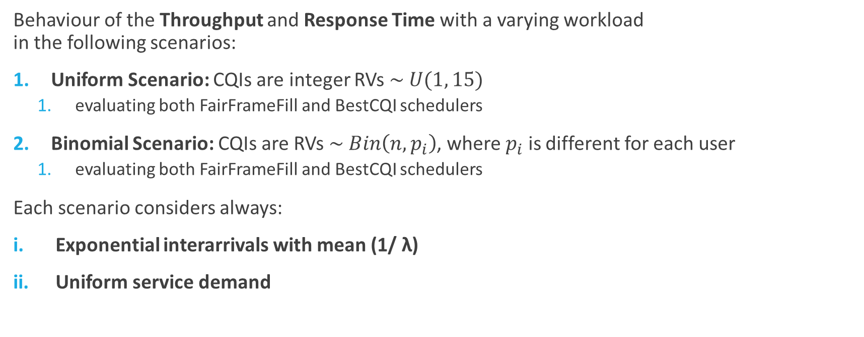
Cellular Network: Case of studies
Behaviour of the Throughput and Response Time with a varying workload in the following scenarios:
Uniform Scenario: CQIs are integer RVs $\sim U(1, 15)$
evaluating both FairFrameFill and BestCQI schedulers
Binomial Scenario: CQIs are RVs $\sim Bin\left(n, p_{i}\right)$, where $p_{i}$ is different for each user
evaluating both FairFrameFill and BestCQI schedulers
Each scenario considers always:
Exponential interarrivals with mean (1/ $\text{λ}$)
Uniform service demand
Antonio Le Caldare, Vincenzo Consales, Vincent della Corte - PECSN
4

Slide 5
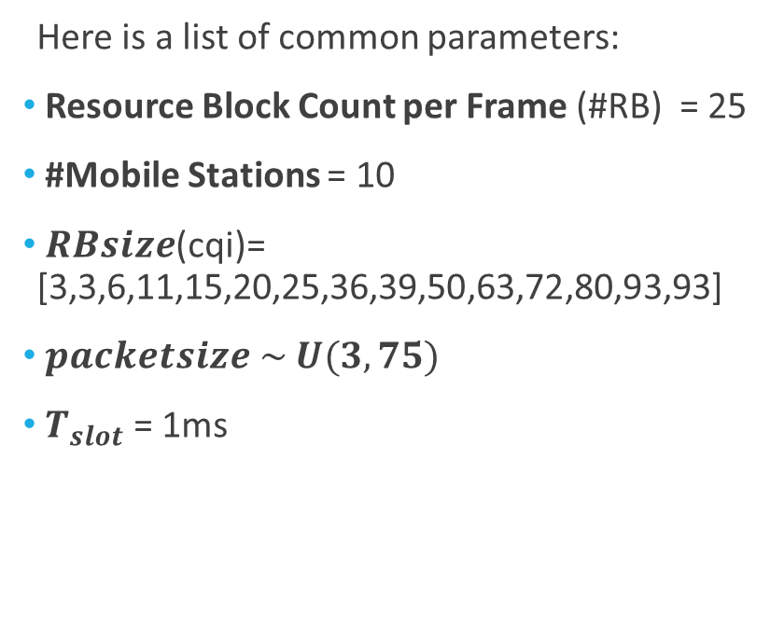
Cellular Network: Simulation Parameters
Here is a list of common parameters:
Resource Block Count per Frame (#RB) = 25
#Mobile Stations = 10
$RBsize$(cqi)= [3,3,6,11,15,20,25,36,39,50,63,72,80,93,93]
$packetsize \sim U(3, 75)$
$T_{slot}$ = 1ms
This are general simulation parameters:
#Repetitions = 10
Simulation Time = 60s
Warm-up period = 0.5s
Antonio Le Caldare, Vincenzo Consales, Vincent della Corte - PECSN
5

Slide 6
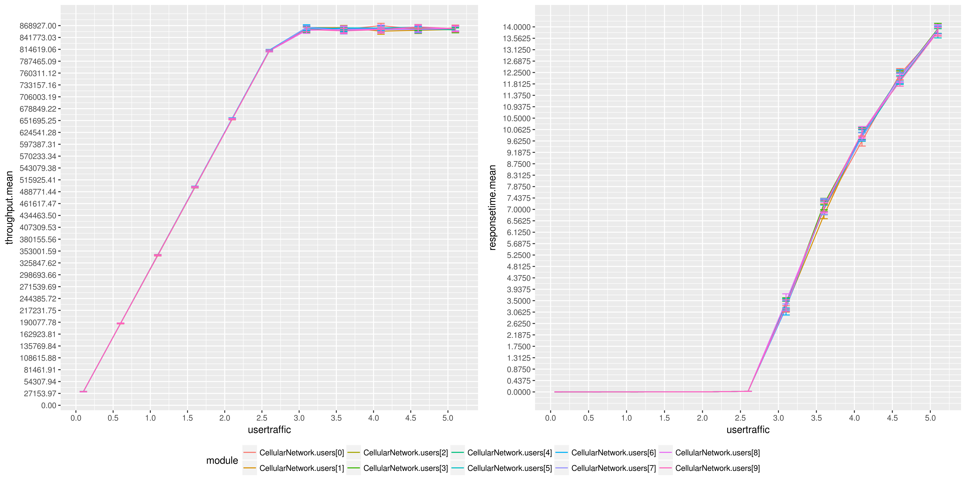
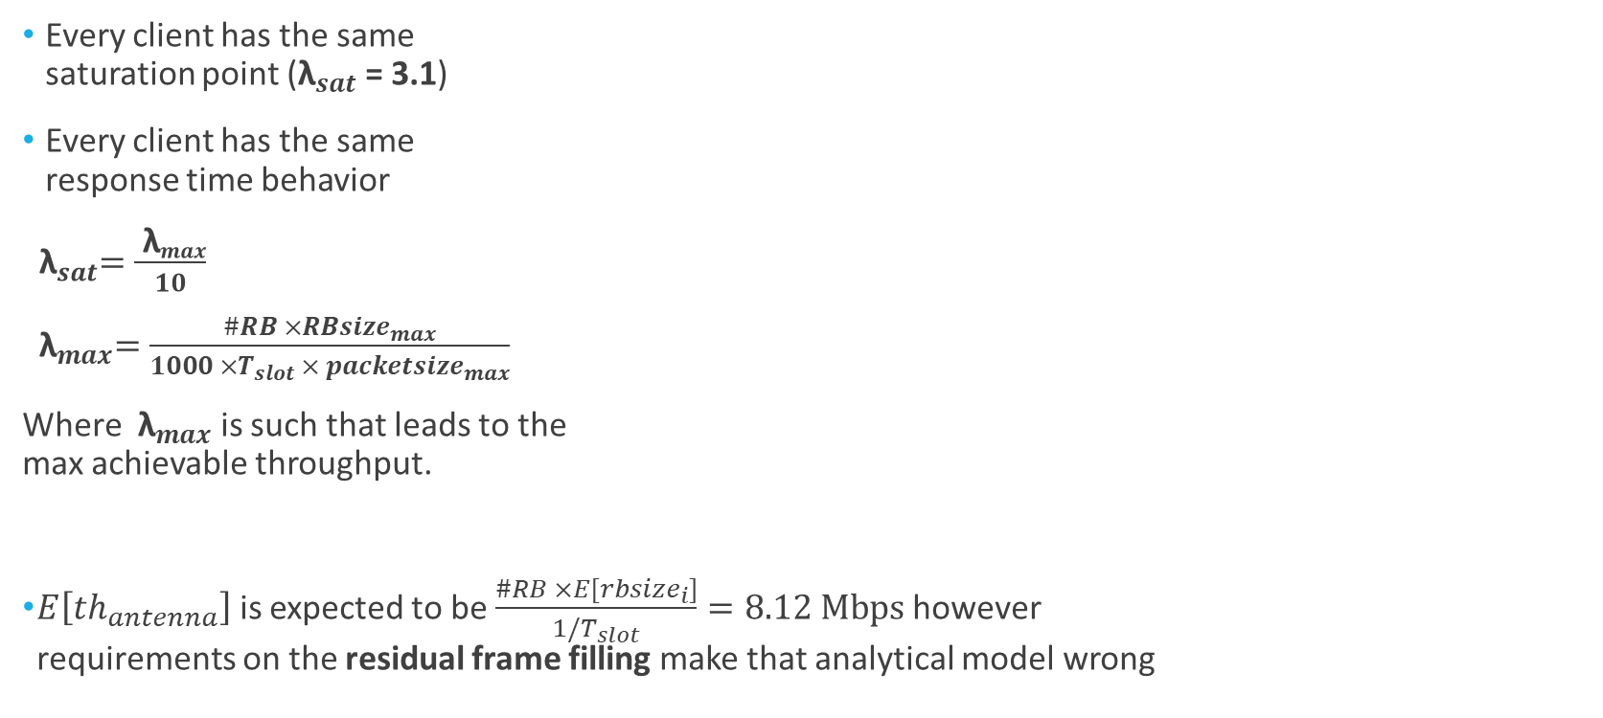
Simulation Results: Uniform Scenario (Fair Scheduler)
Every client has the same saturation point (${\text{λ}}_{sat}$ = 3.1)
Every client has the same response time behavior
${ \text{λ}}_{sat}=\frac{{ \text{λ}}_{max}}{10}$
${ \text{λ}}_{max}=\frac{\#RB ×{RBsize}_{max}}{1000 ×T_{slot} × {packetsize}_{max}}$
Where ${ \text{λ}}_{max}$ is such that leads to the max achievable throughput.
$E\left[{th}_{antenna}\right]$ is expected to be $\frac{\#RB ×E[{rbsize}_{i}]}{1/T_{slot}}=8.12 Mbps$ however requirements on the residual frame filling make that analytical model wrong
Antonio Le Caldare, Vincenzo Consales, Vincent della Corte - PECSN
6

Slide 7
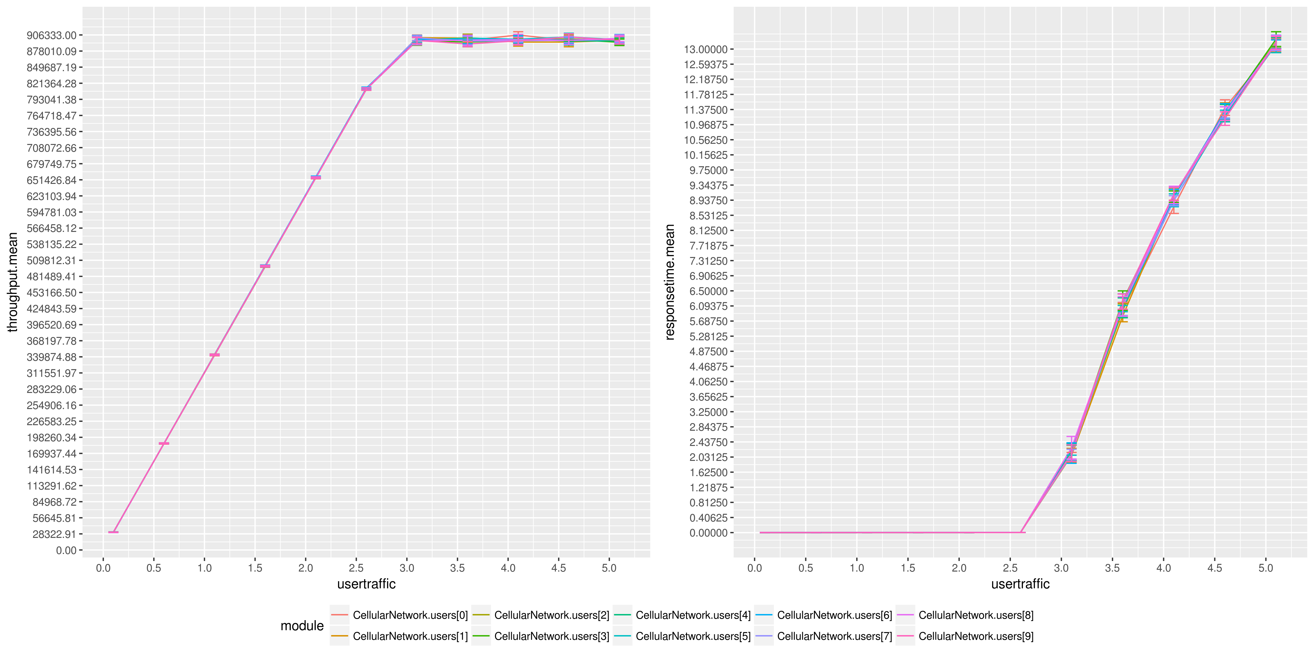
Simulation Results: Uniform Scenario (BestCQI Scheduler)
Saturation points are almost the same as the previous simulation
Higher User Throughput
users with higher CQIs can carry more packets than the worst ones
Same Throughput Fairness
CQIs are uniformly distributed for each user, as the probability of getting the higher CQI
Lower Response Times
Antonio Le Caldare, Vincenzo Consales, Vincent della Corte - PECSN
7

Slide 8
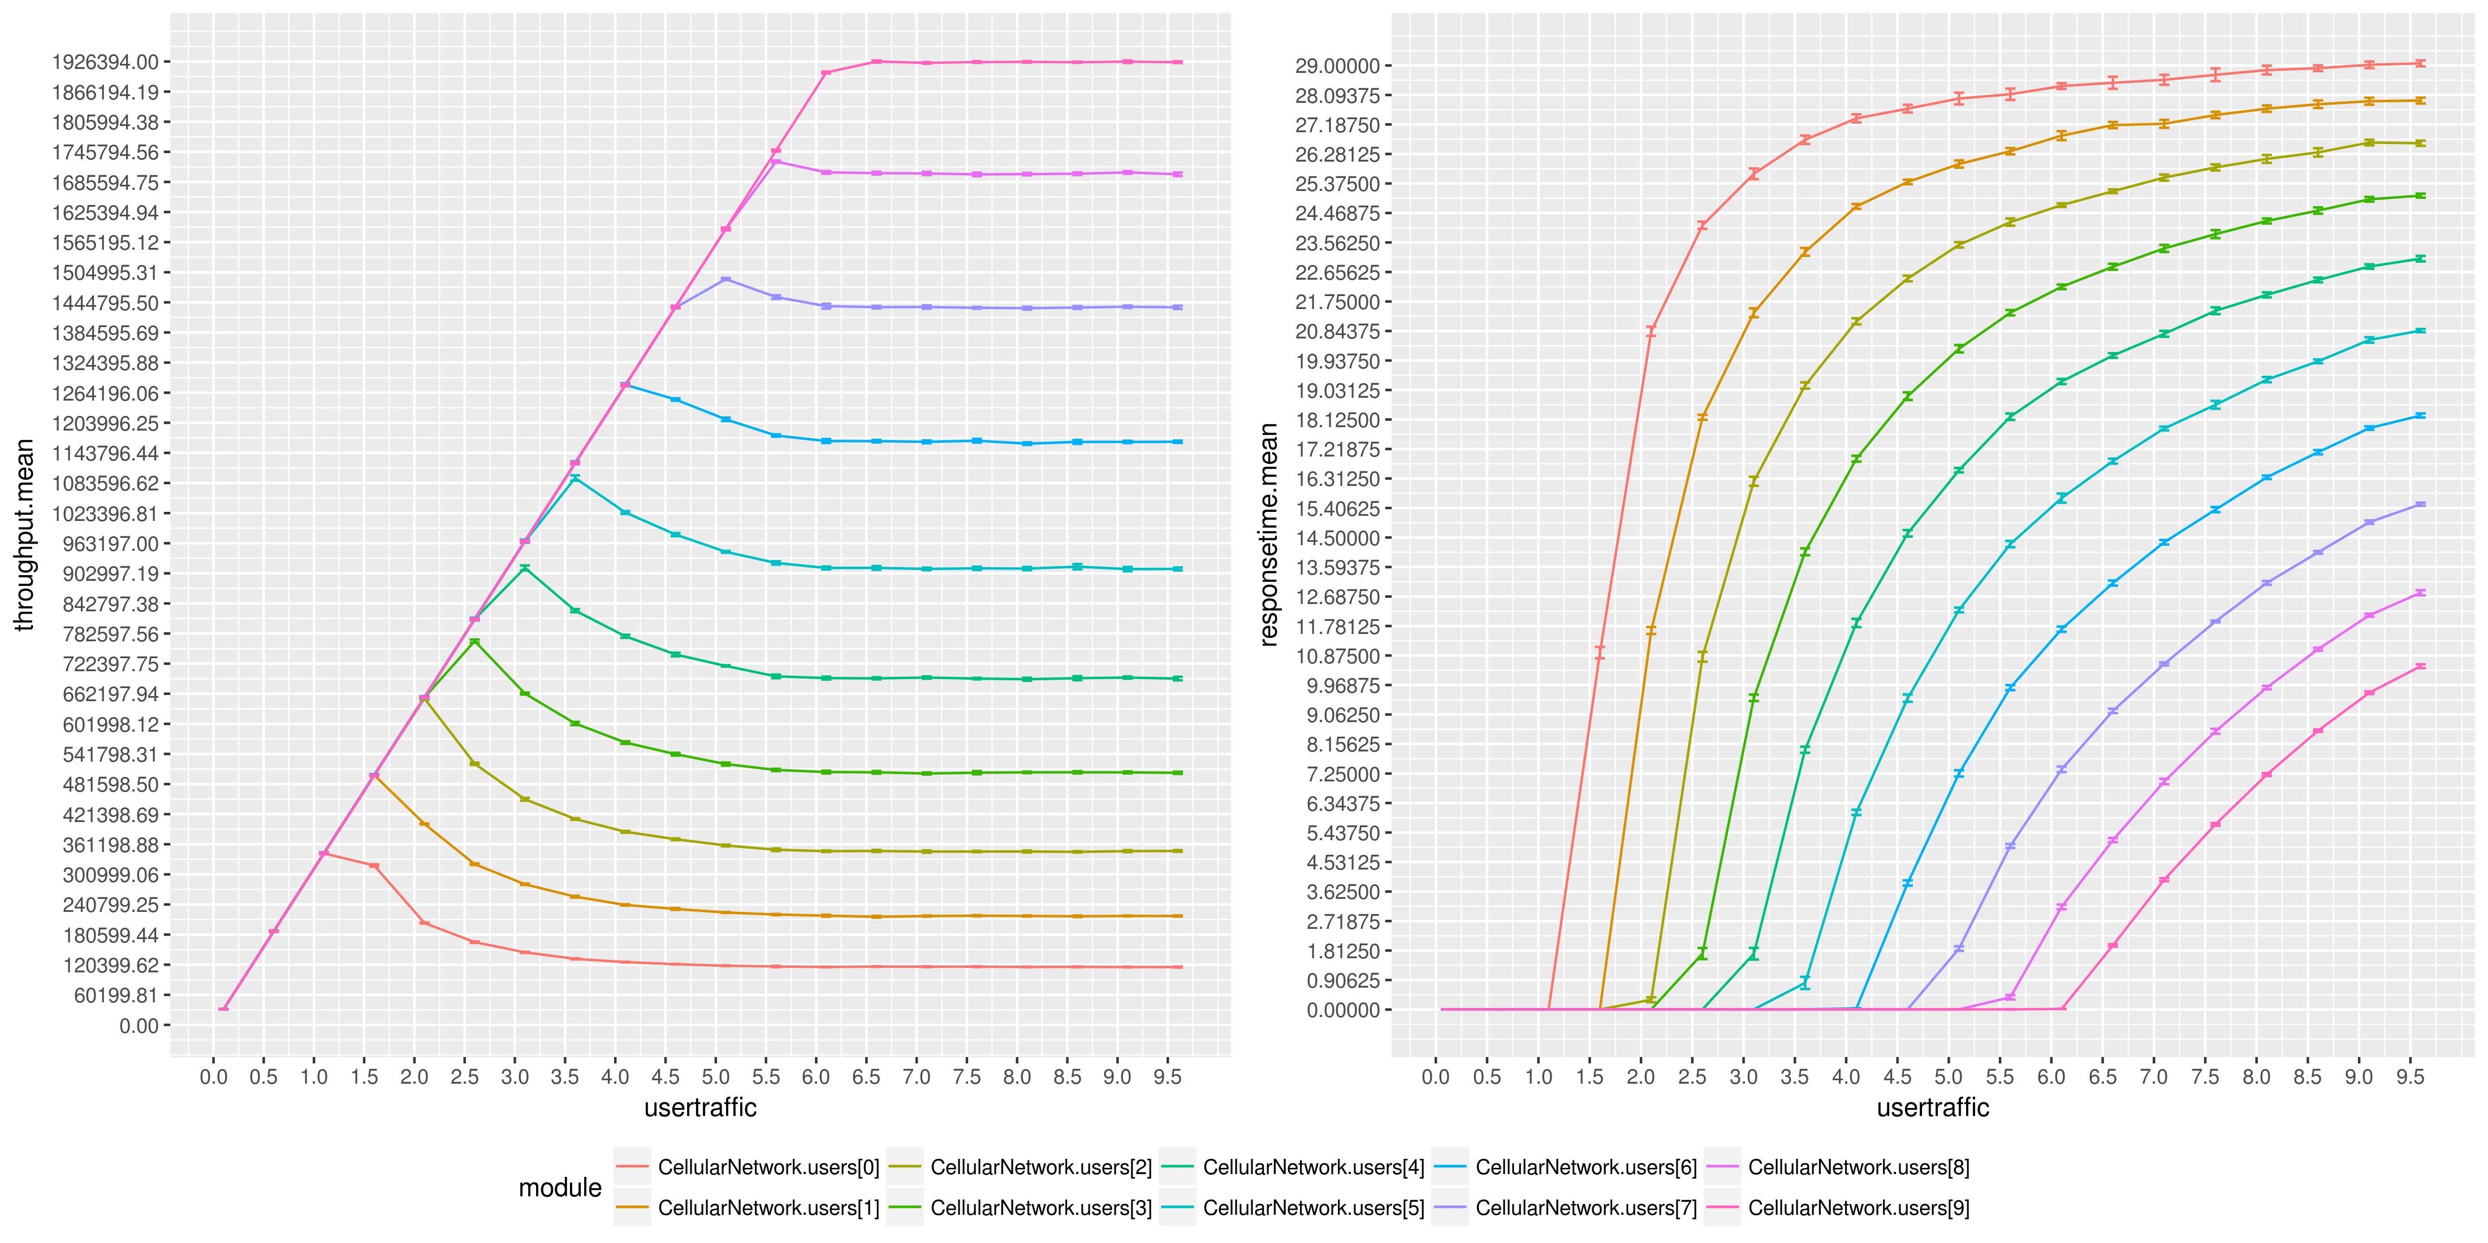
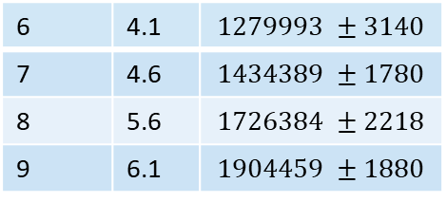
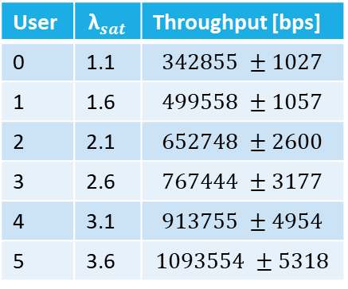
Simulation Results: Binomial Scenario (Fair Scheduler)
Each user has its own saturation point depending on its mean CQI
Different Throughputs/RespTimes
Throughput Peaks before saturation due to packet allocation policies
Throughput Unfairness
Better mean CQI leads to better RB mean size
User | $${\text{λ}}_{sat}$$ | Throughput [bps]
0 | 1.1 | $$342855 ±1027$$
1 | 1.6 | $$499558 ±1057$$
2 | 2.1 | $$652748 ±2600$$
3 | 2.6 | $$767444 ±3177$$
4 | 3.1 | $$913755 ±4954$$
5 | 3.6 | $$1093554 ±5318$$
6 | 4.1 | $$1279993 ±3140$$
7 | 4.6 | $$1434389 ±1780$$
8 | 5.6 | $$1726384 ±2218$$
9 | 6.1 | $$1904459 ±1880$$
Antonio Le Caldare, Vincenzo Consales, Vincent della Corte - PECSN
8

Slide 9
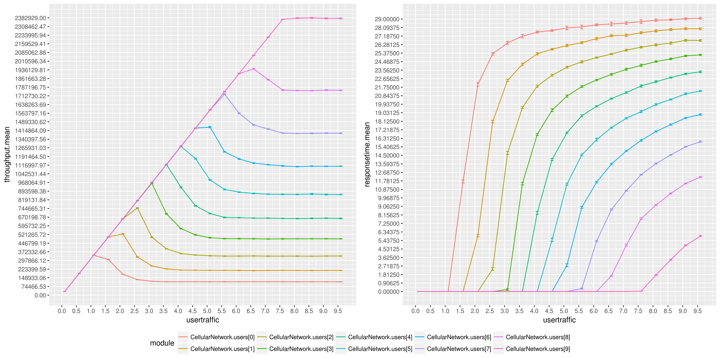
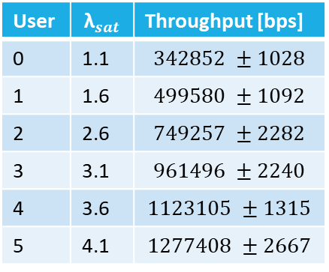
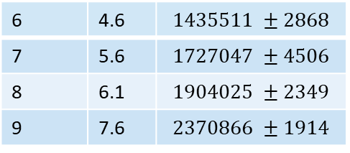
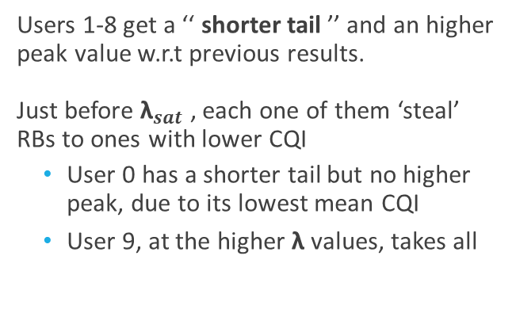
Simulation Results: Binomial Scenario (BestCQI Scheduler)
Users 1-8 get a ‘‘ shorter tail ’’ and an higher peak value w.r.t previous results. Just before ${\text{λ}}_{sat}$ , each one of them ‘steal’ RBs to ones with lower CQI
User 0 has a shorter tail but no higher peak, due to its lowest mean CQI
User 9, at the higher $\text{λ}$ values, takes all
User | $${\text{λ}}_{sat}$$ | Throughput [bps]
0 | 1.1 | $$342852 ±1028$$
1 | 1.6 | $$499580 ±1092$$
2 | 2.6 | $$749257 ±2282$$
3 | 3.1 | $$961496 ±2240$$
4 | 3.6 | $$1123105 ±1315$$
5 | 4.1 | $$1277408 ±2667$$
6 | 4.6 | $$1435511 ±2868$$
7 | 5.6 | $$1727047 ±4506$$
8 | 6.1 | $$1904025 ±2349$$
9 | 7.6 | $$2370866 ±1914$$
Antonio Le Caldare, Vincenzo Consales, Vincent della Corte - PECSN
9

Slide 10
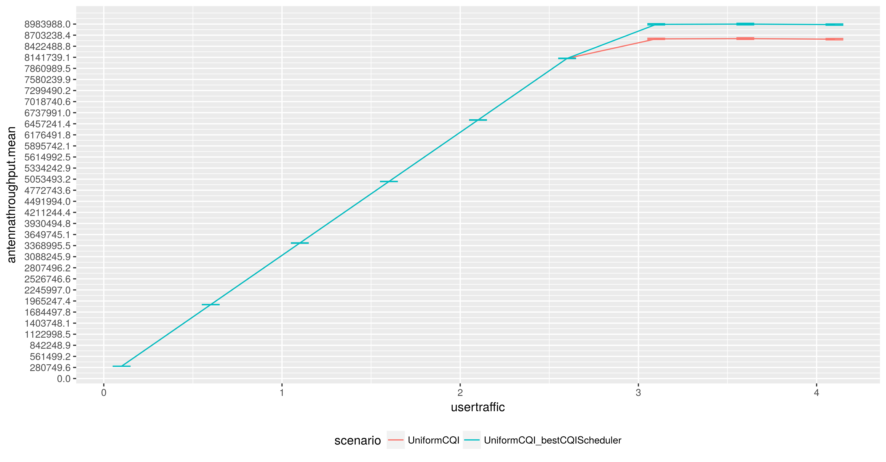
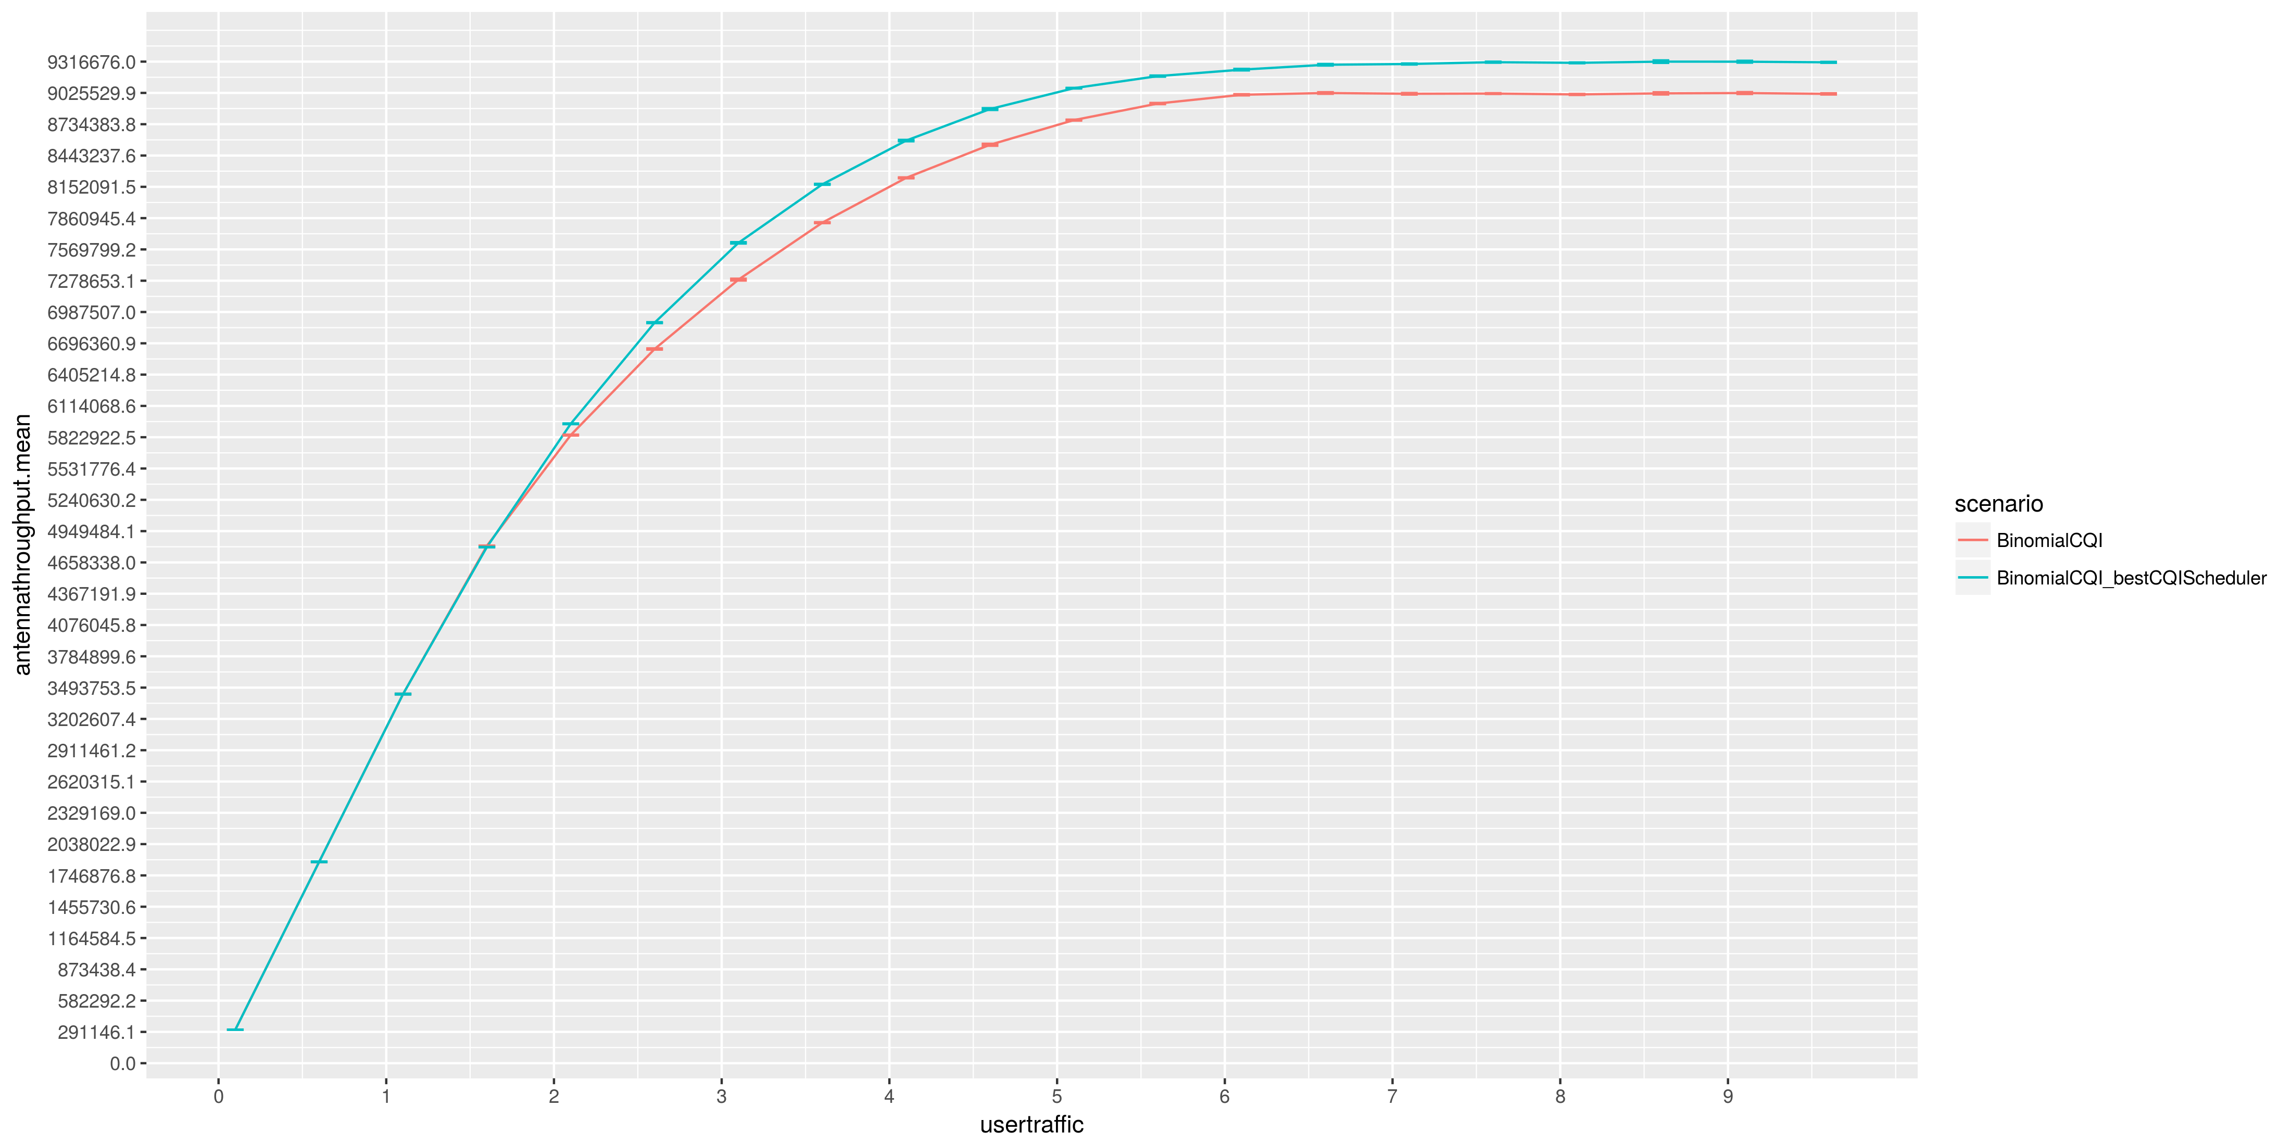
Conclusions (1/3)
Best-CQI based frame scheduler provides higher total throughput than Fair one in both scenarios, maintaining the same level of fairness in the Uniform CQIs scenario
Antonio Le Caldare, Vincenzo Consales, Vincent della Corte - PECSN
10

Slide 11
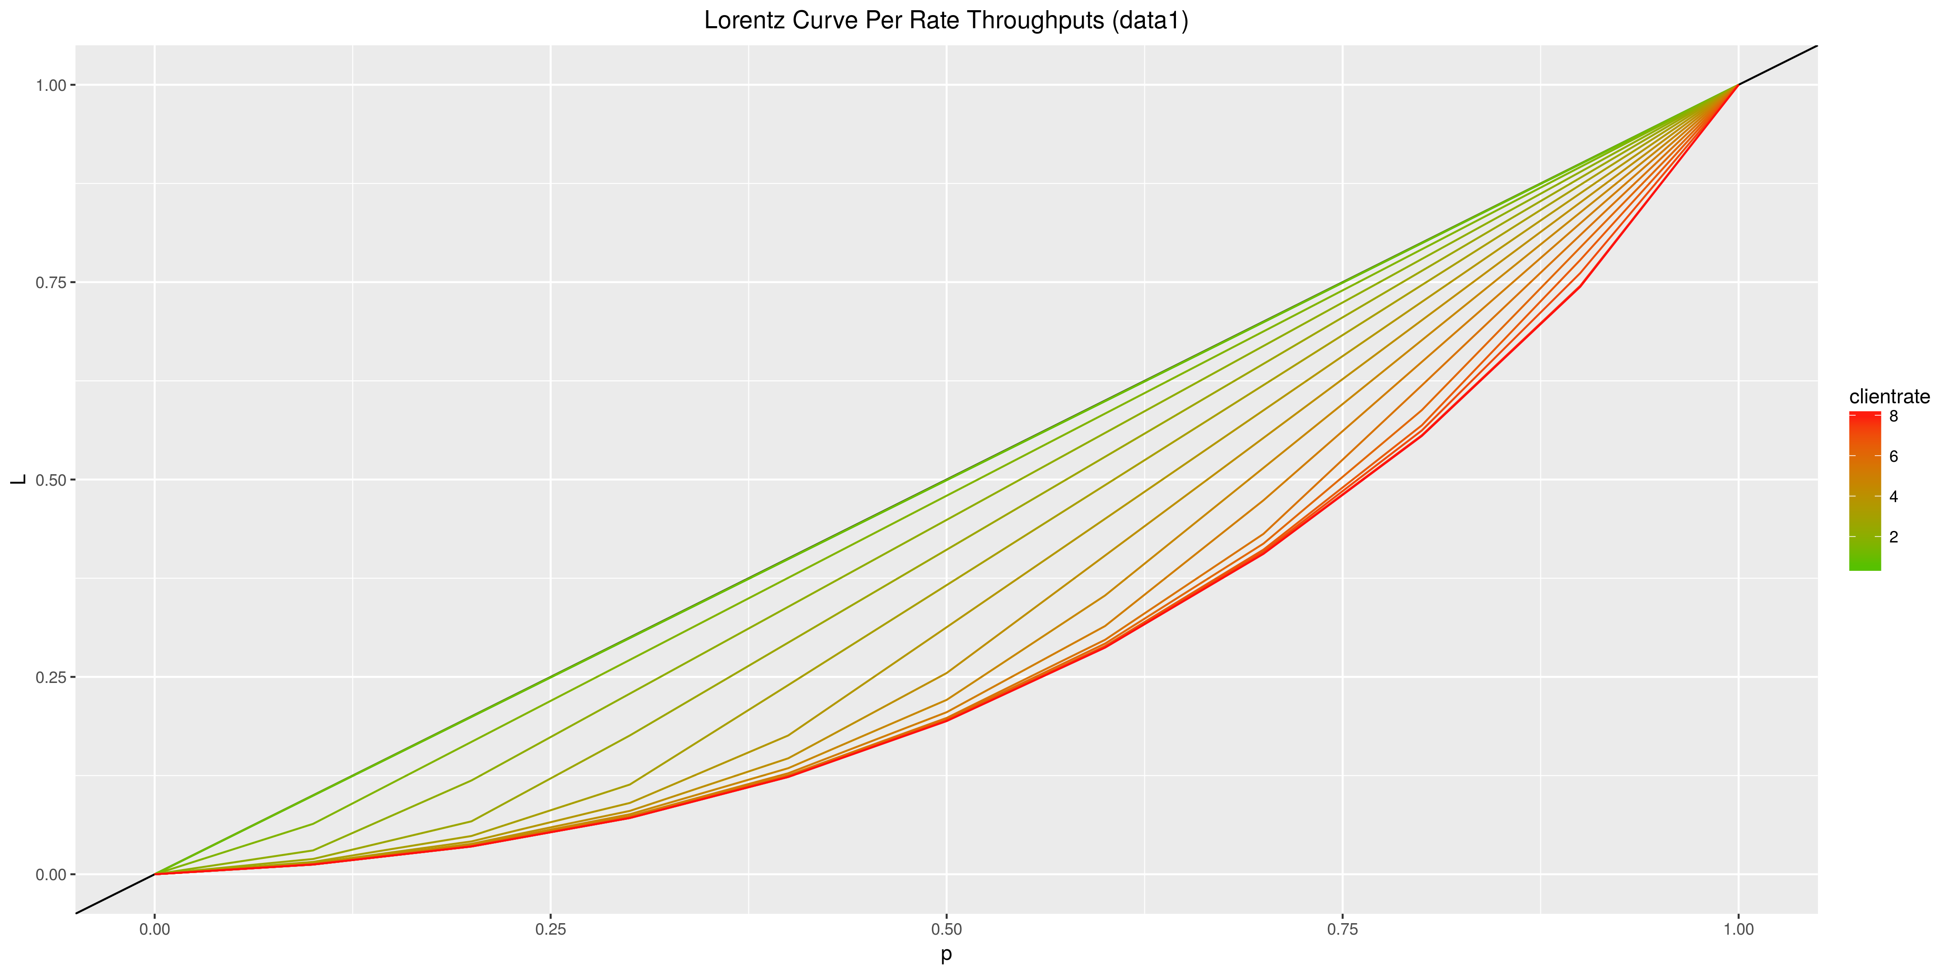
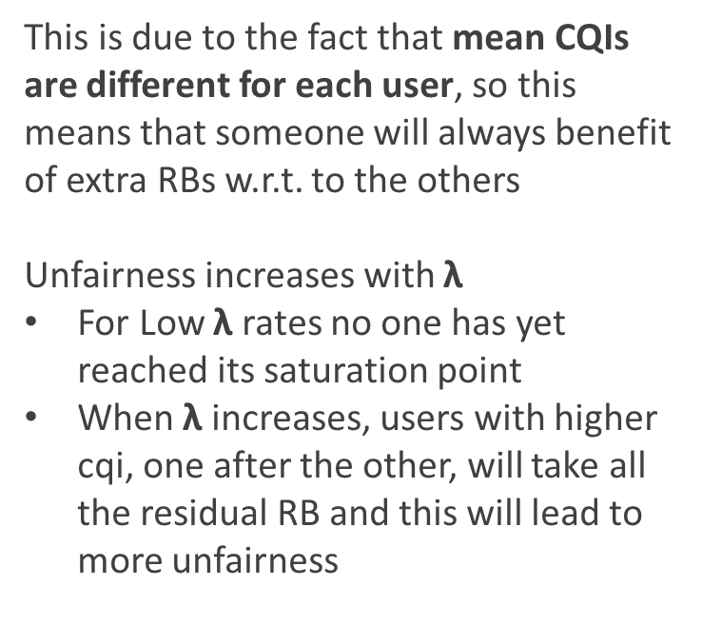
Conclusions (2/3)
However it is also true that it is less fair when considering Binomial CQIs scenario:
This is due to the fact that mean CQIs are different for each user, so this means that someone will always benefit of extra RBs w.r.t. to the others Unfairness increases with $\text{λ}$
For Low $\text{λ}$ rates no one has yet reached its saturation point
When $\text{λ}$ increases, users with higher cqi, one after the other, will take all the residual RB and this will lead to more unfairness
Antonio Le Caldare, Vincenzo Consales, Vincent della Corte - PECSN
11

Slide 12
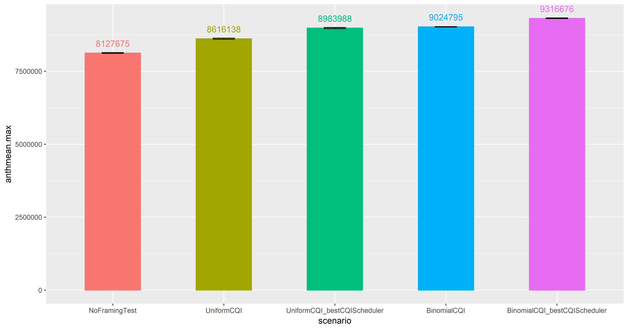
Conclusions (3/3)
Residual Frame Filling policies had an unexpected impact on system performances. Anyhow it’s difficult to build an analytical model because of framing and the imposed requirements
Antonio Le Caldare, Vincenzo Consales, Vincent della Corte - PECSN
12

